Slide 1


Alpha Phi Omega
Chi Chapter at UCLA
Alpha Kappa / David A. Emery Term, Meeting 2
October 16, 2013
www.apo-x.org

Slide 2
Agenda
1. Alpha Iota Certificates
2. Officer Updates and Announcements
3. Chapter Business
4. Last Announcements

Slide 3
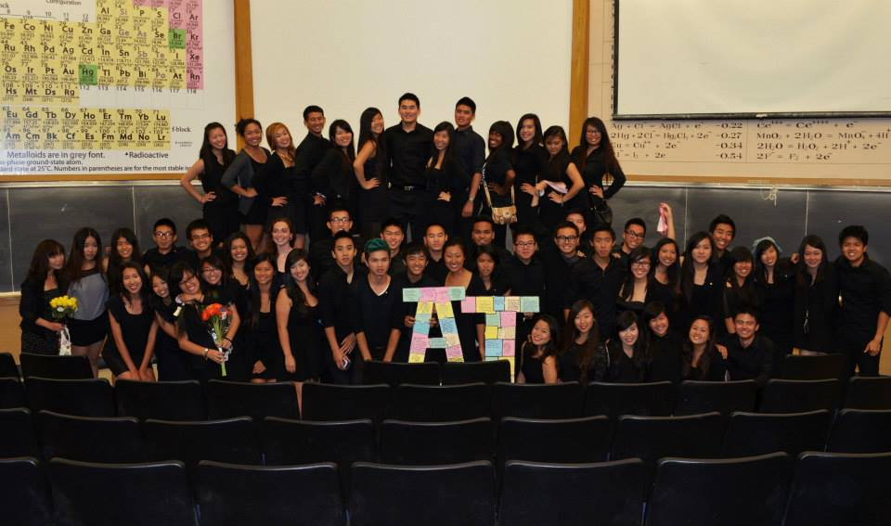
Congratulations Alpha Iota!

Slide 4
President
Holly Fuong
president@apo-x.org
Executive Committee
excomm@apo-x.org

Slide 5
Philanthropy Chairs
What do we do?
In charge of establishing a strong working relationship with an organization of the chapter’s choice
In charge of organizing service projects with the above organization
We are the ones planning the event, rather than us going to an event planned for us

Slide 6

Belmont Village Senior Living

Slide 7
APO Service
Arranging donated books
Start early November
Encourage volunteers to continue working with this organization in the future when we have more events
Arts and Crafts with Senior Citizens with Alzheimer’s
Waiting for medical clearance details

Slide 8

Vista Del Mar
Offers a range of programs in education, mental health, autism, adoption, residential care

Slide 9
APO Service
Working with foster children
Volunteers must be above 21 years old

Slide 10
[L] LAUNCH
Dates are posted online.
Next one: Tomorrow at 7pm!!
Pledges, these are the only 4 opportunities and you need it to cross! Please contact me if you have any questions/concerns.
Actives, you cannot retake LAUNCH if you already took it.

Slide 11
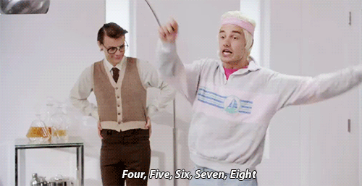
Leadership Workshops
apo.org calendar has more opportunities. Notify me 3 days in advance if interested.
Want to host a workshop? Please contact me.

Slide 12
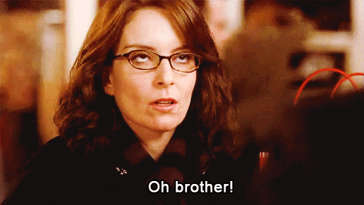
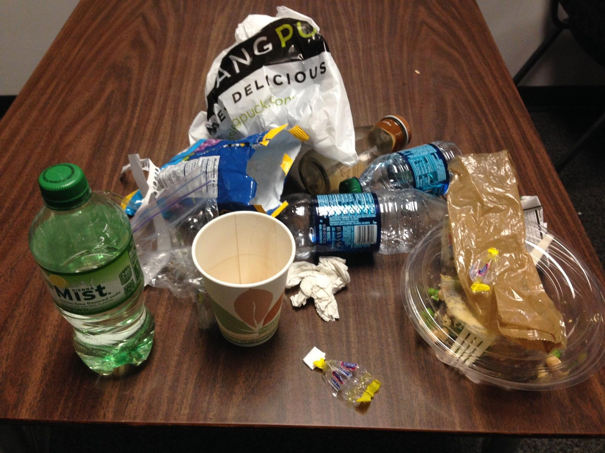
TRASH!!!

Slide 13
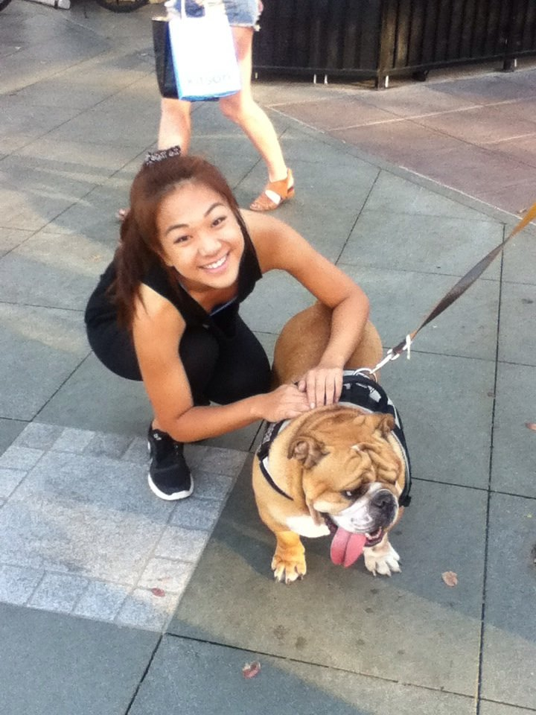
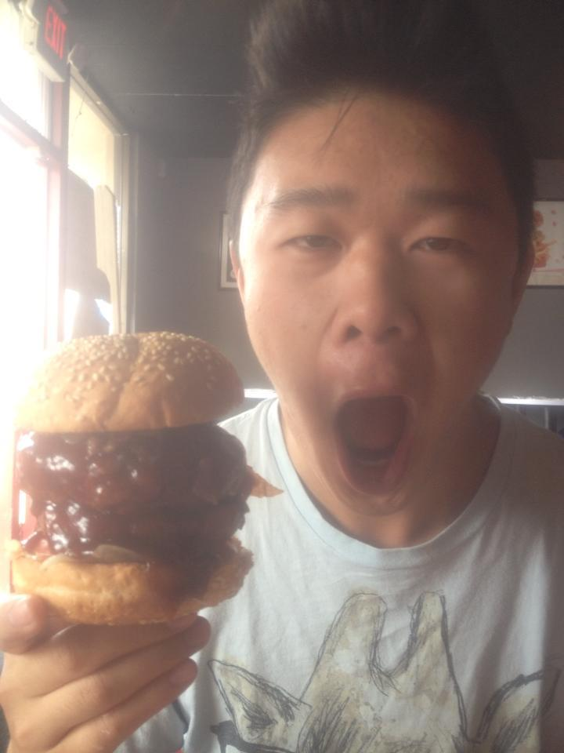
TRASH!!!
Special thank you to Michael Hung & Diane Huynh for picking it up after last meeting. :)

Slide 14
Administrative VPs
Jacqueline Pan & Melanie Teepronpirut
admin@apo-x.org

Slide 15
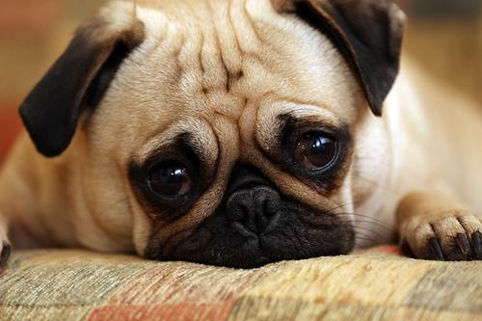
Pledges!
Please send us your profile pictures for the website!!
apoxadmin@gmail.com
Puppy is waiting to
see your beautiful faces :3

Slide 16
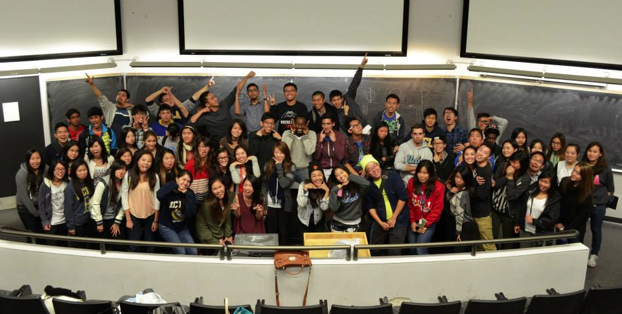
Follow us on Instagram
@apoucla; text us pictures!

Slide 17
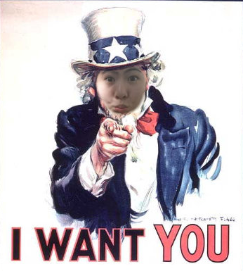

Join our committees !
Alumni Relations (3)
Help us plan events with alumni
Organize alumni networking night
Newsletter/Website (3)
Design pages for the bi-weekly newsletter
Provide ideas to fix up the website

Slide 18
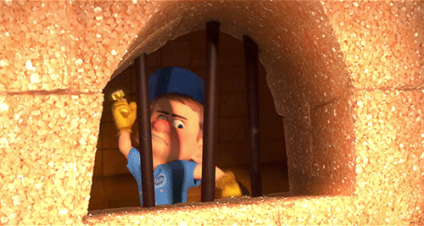
Website update!
Goals:
-Fix-up tabs/functions we don’t use
-Improve the look of the website in general
Suggestions? Email us!

Slide 19
Membership VPs
Vivian Kwan & Sean Tran
membership@apo-x.org

Slide 20

Business
Active Bonding Day
Contracts are out
Rush Make ups
retreat date is set :)

Slide 21
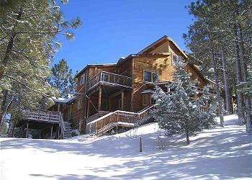
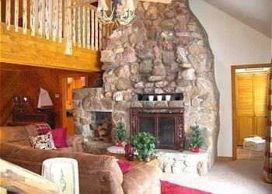
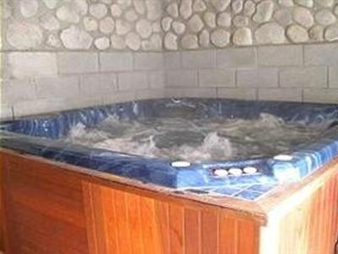
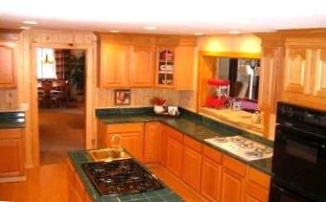
Chapter Retreat 1
Min 2 Nights
57 Dollars each
Hot tub/jetted tub
7 bedrooms
6.5 bath

Slide 22
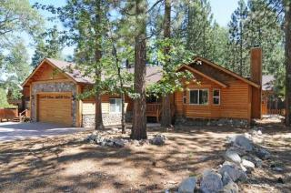
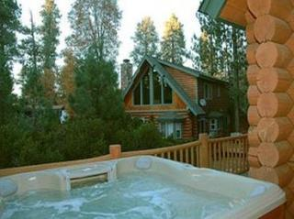
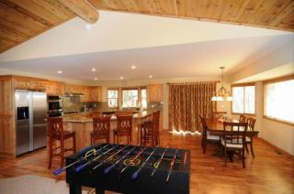
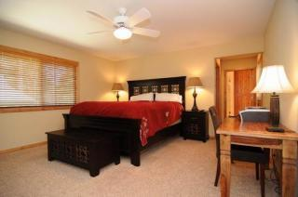
Chapter Retreat Cabin 2
Min 2 Nights
$ currently asking
3 adjacent houses
10 bed 6.5 bath
spa/pooltable/tv’s

Slide 23
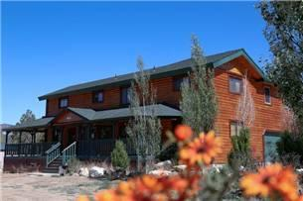
Chapter Retreat Cabin 3
Min 2 Nights
42 Dollars each
1 big house
5 bed 3 bath
spa/pooltable/tv’s
http://www.bigbearcoolcabins.com/book-bbbigcab.html

Slide 24
Family Heads!

Slide 25
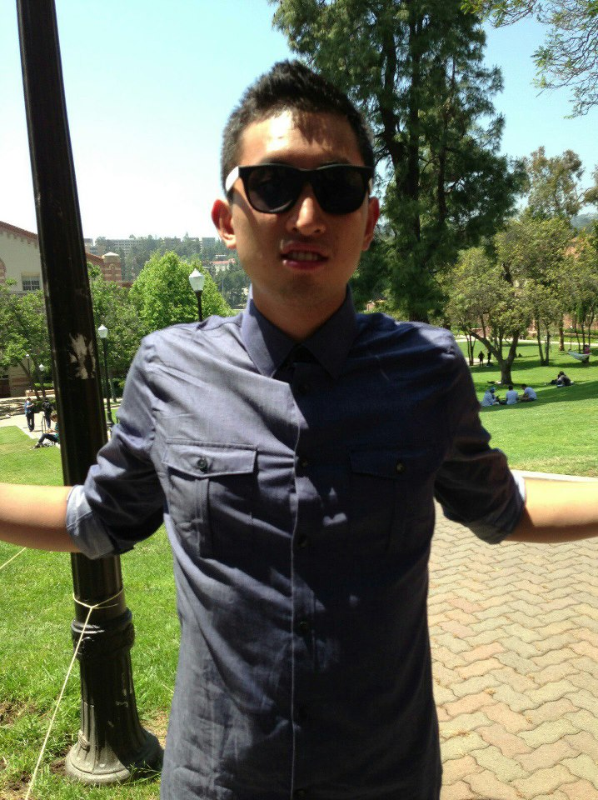
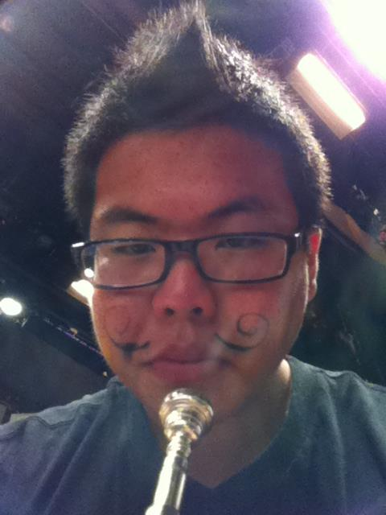
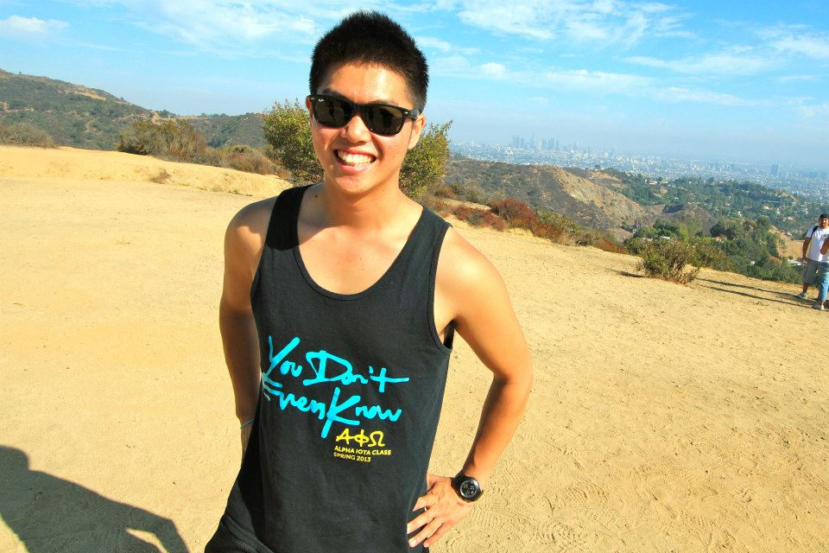
Spirit Committee

Slide 26
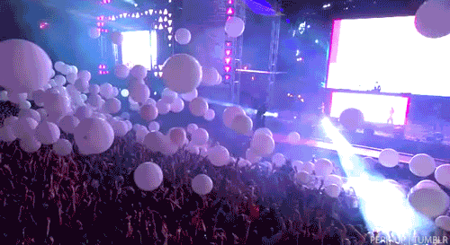
Next week’s theme!

Slide 27

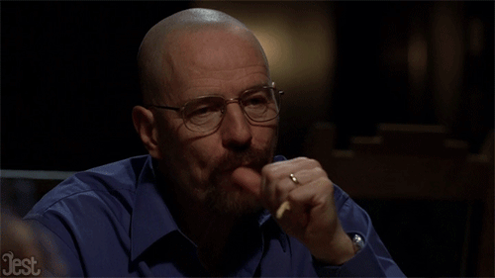
GAME TIME: Well that was awk

Slide 28
Service VPs
Kevin Qiu & Gabrielle Taylor
service@apo-x.org

Slide 29

APO Blood Drive!
In November
5th
7th
12th
14th

Slide 30

Drivers Wanted!
Trick-Or-Treat Bag Making

Slide 31
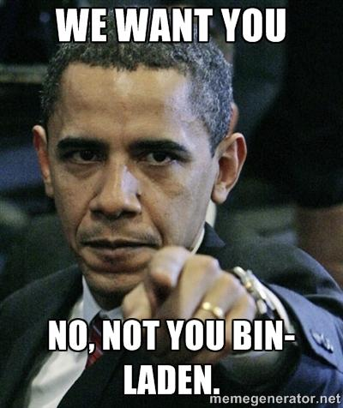
Events to Look Out For
STAR Enchanted Hallows Eve
Stone Creek Restoration with Circle K!
Divine Design

Slide 32
Pledge Parents
Hamilton Luu & David Yuan
pledgeparents@apo-x.org

Slide 33
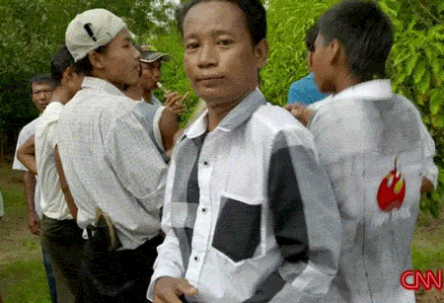
Campout
Drivers
Supplies
October 25-27

Slide 34
Reminder
Understanding and delineating the Pledge/Active line goes both ways
Don’t put yourself in a position where pledges can think it’s okay to ever cross that line while pledging Alpha Phi Omega

Slide 35
Recap
Quiz: roster, cardinal principles, fraternity motto
Mission: class unity and autobiography
Pledge Bonding Day
Interview: 8 actives/8 pledges
Quiz #2: Excomm, mission, toast song
Mission #2: 4 part harmony toast song

Slide 36
Finance VPs
Alejandra Chavez & Raymond Mai
finance@apo-x.org

Slide 37

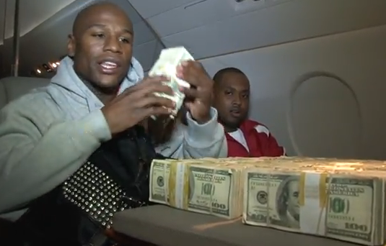
Dues/Budget
Make sure to pay $75.00 by next week (CM3)
By cash or by checks made to
Alpha Phi Omega - Chi Chapter
We’ll be staying after meeting to collect money
Budget will be sent out this Sunday; approved CM3

Slide 38

Fundraisers
Rubio’s Fundraiser on Friday, October 18
TV Taping “DADS” on October 22
Veggie Grill
TV Taping

Slide 39
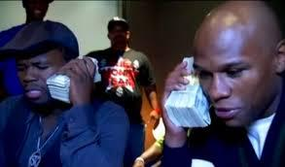
TV Taping Etiquette
Get there on time
It’s a long time
Don’t fall asleep
No cell phones

Slide 40
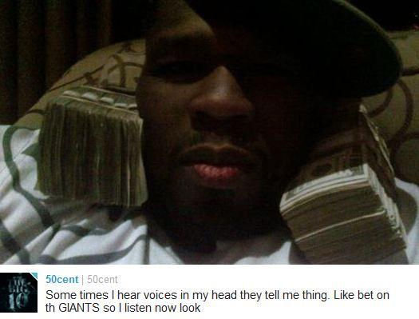
Reminders
Flyering
TV taping on Wednesdays?
Need 5 ACTIVES for $18
Cake pop bake sell- next week

Slide 41
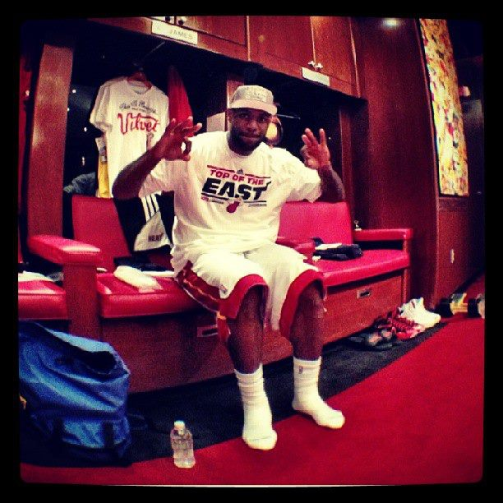
#SwagLyfe

Slide 42
Fellowship VPs
Jessica Cui & Kevin Quizon
fellowship@apo-x.org

Slide 43
SECRET BROTHER SIGN UPS ARE CLOSING TONIGHT
Secret Brother Sign Ups will be officially CLOSED TONIGHT.
We will be pairing up people this week and your “Secret Brother” will be sent out by this weekend!
TASK 1 Due by CM 4 is...
“SECRETLY” find out what your brother’s favorite food/snack is and bring it to CM 4. Also put a note of encouragement! :)

Slide 44

How to Turn in Stuff
-PLEASE don’t give it to your secret brother directly.
-Be sure to write THEIR name on it (NOT YOURS).
-Turn it into us or committee before or at meeting!
-Our committee will check you off for credit!
-Our committee will then hand out the gifts! :)

Slide 45
Come Support us at IM Team
-Volleyball and Football have both started!
-If you are still interested, you can always sign up mid season!
-If there is enough support, we will be getting shirts

Slide 46

THANK YOU VOLLEYBALL :)
THANKS TO OLIVIA, LINDA, JERON AND PAUL FOR COMING OUT TO VOLLEYBALL ON MONDAY
Come support your brothers!
There is a 25 dollar penalty fee when we can’t make a game!

Slide 47
Next IM games!
-FOOTBALL this thursday at 7
-VOLLEYBALL next monday at 730 at SAC
-Please come out to support your brothers and/or to play yourself!
-Remember to bring Bruin Card.

Slide 48
Looking Good Night
Date: November 22, 2013
Locations (Tentative)
Shanghai Reds (Marina Del Rey)
The Dragon (Los Angeles)
CAPPED: 100-120 People

Slide 49

Sign Up for Events!
Pumpkin Carving 10/22

Slide 50
Historian
Selena Saenz
historian@apo-x.org

Slide 51
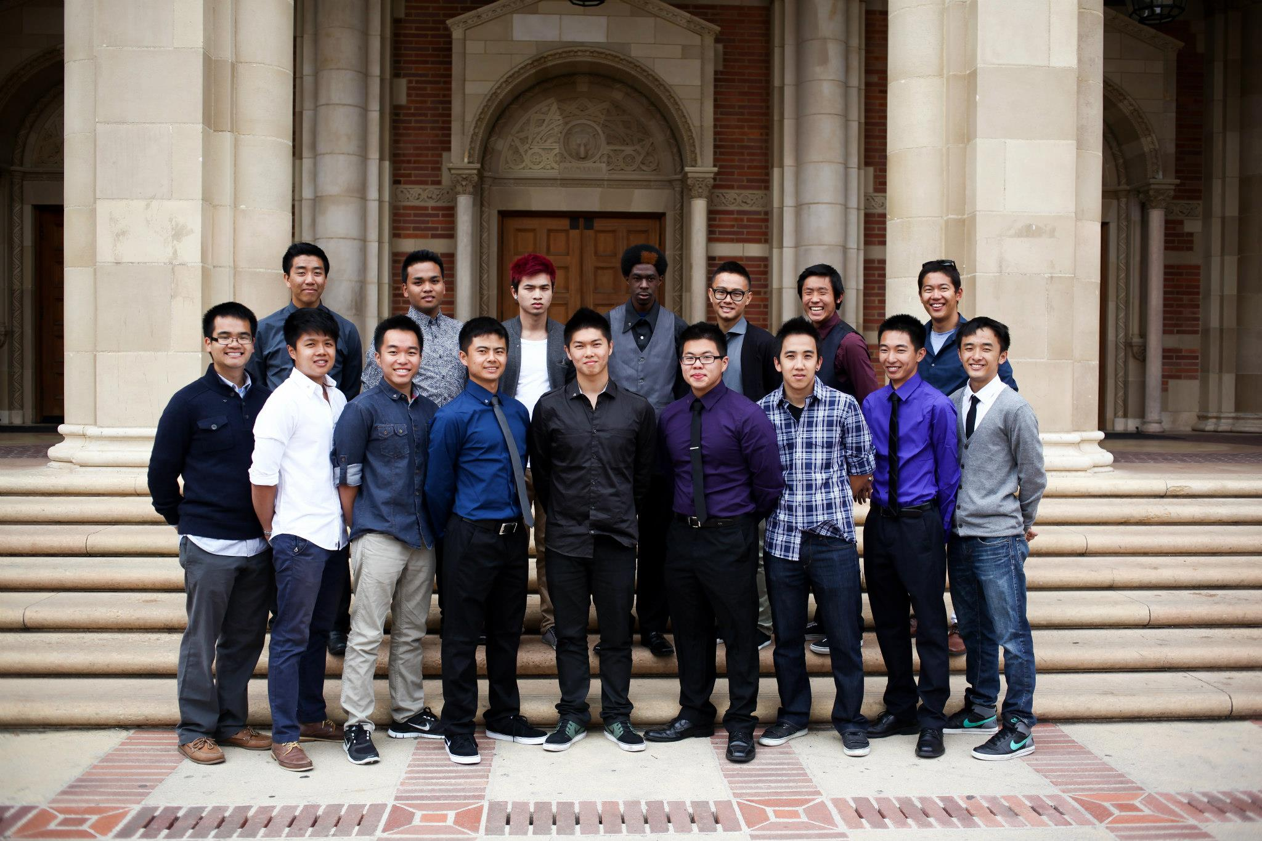
Top Hit of the Week!

Slide 52
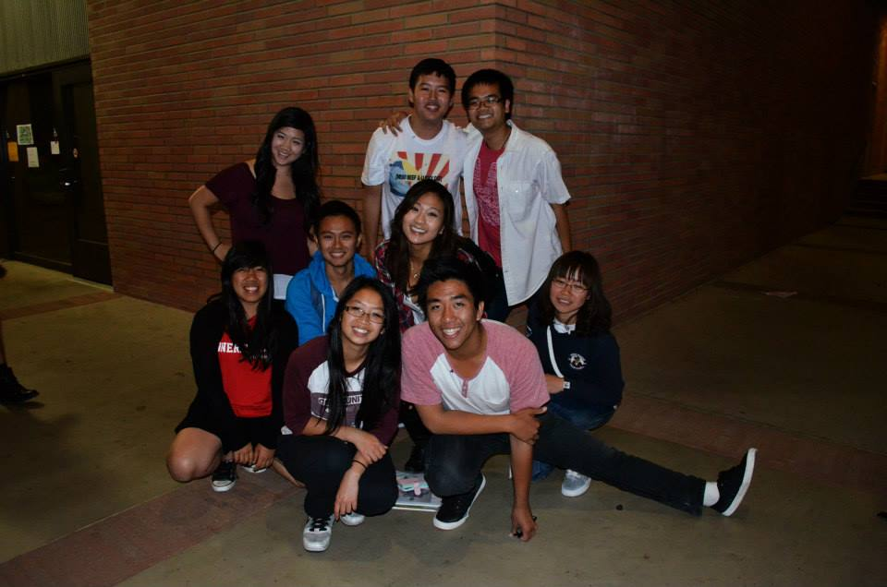
Top Hit of the Week!

Slide 53
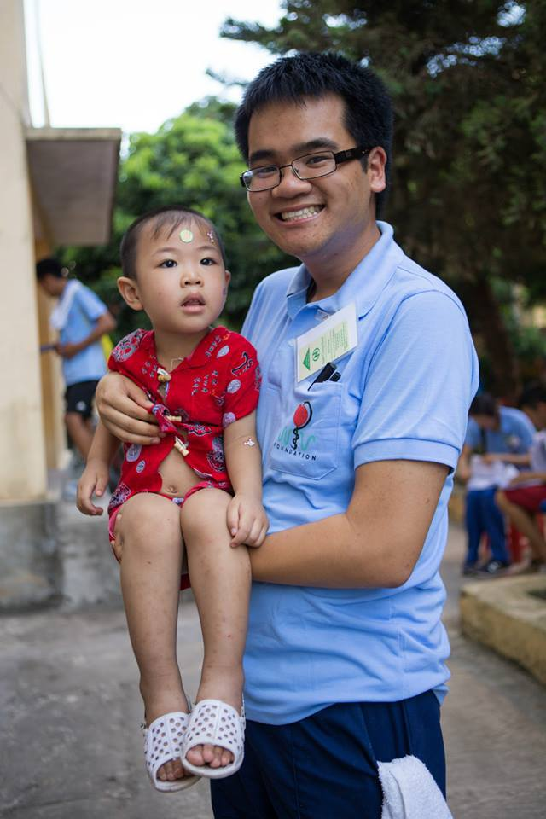
Top Hit of the Week!

Slide 54
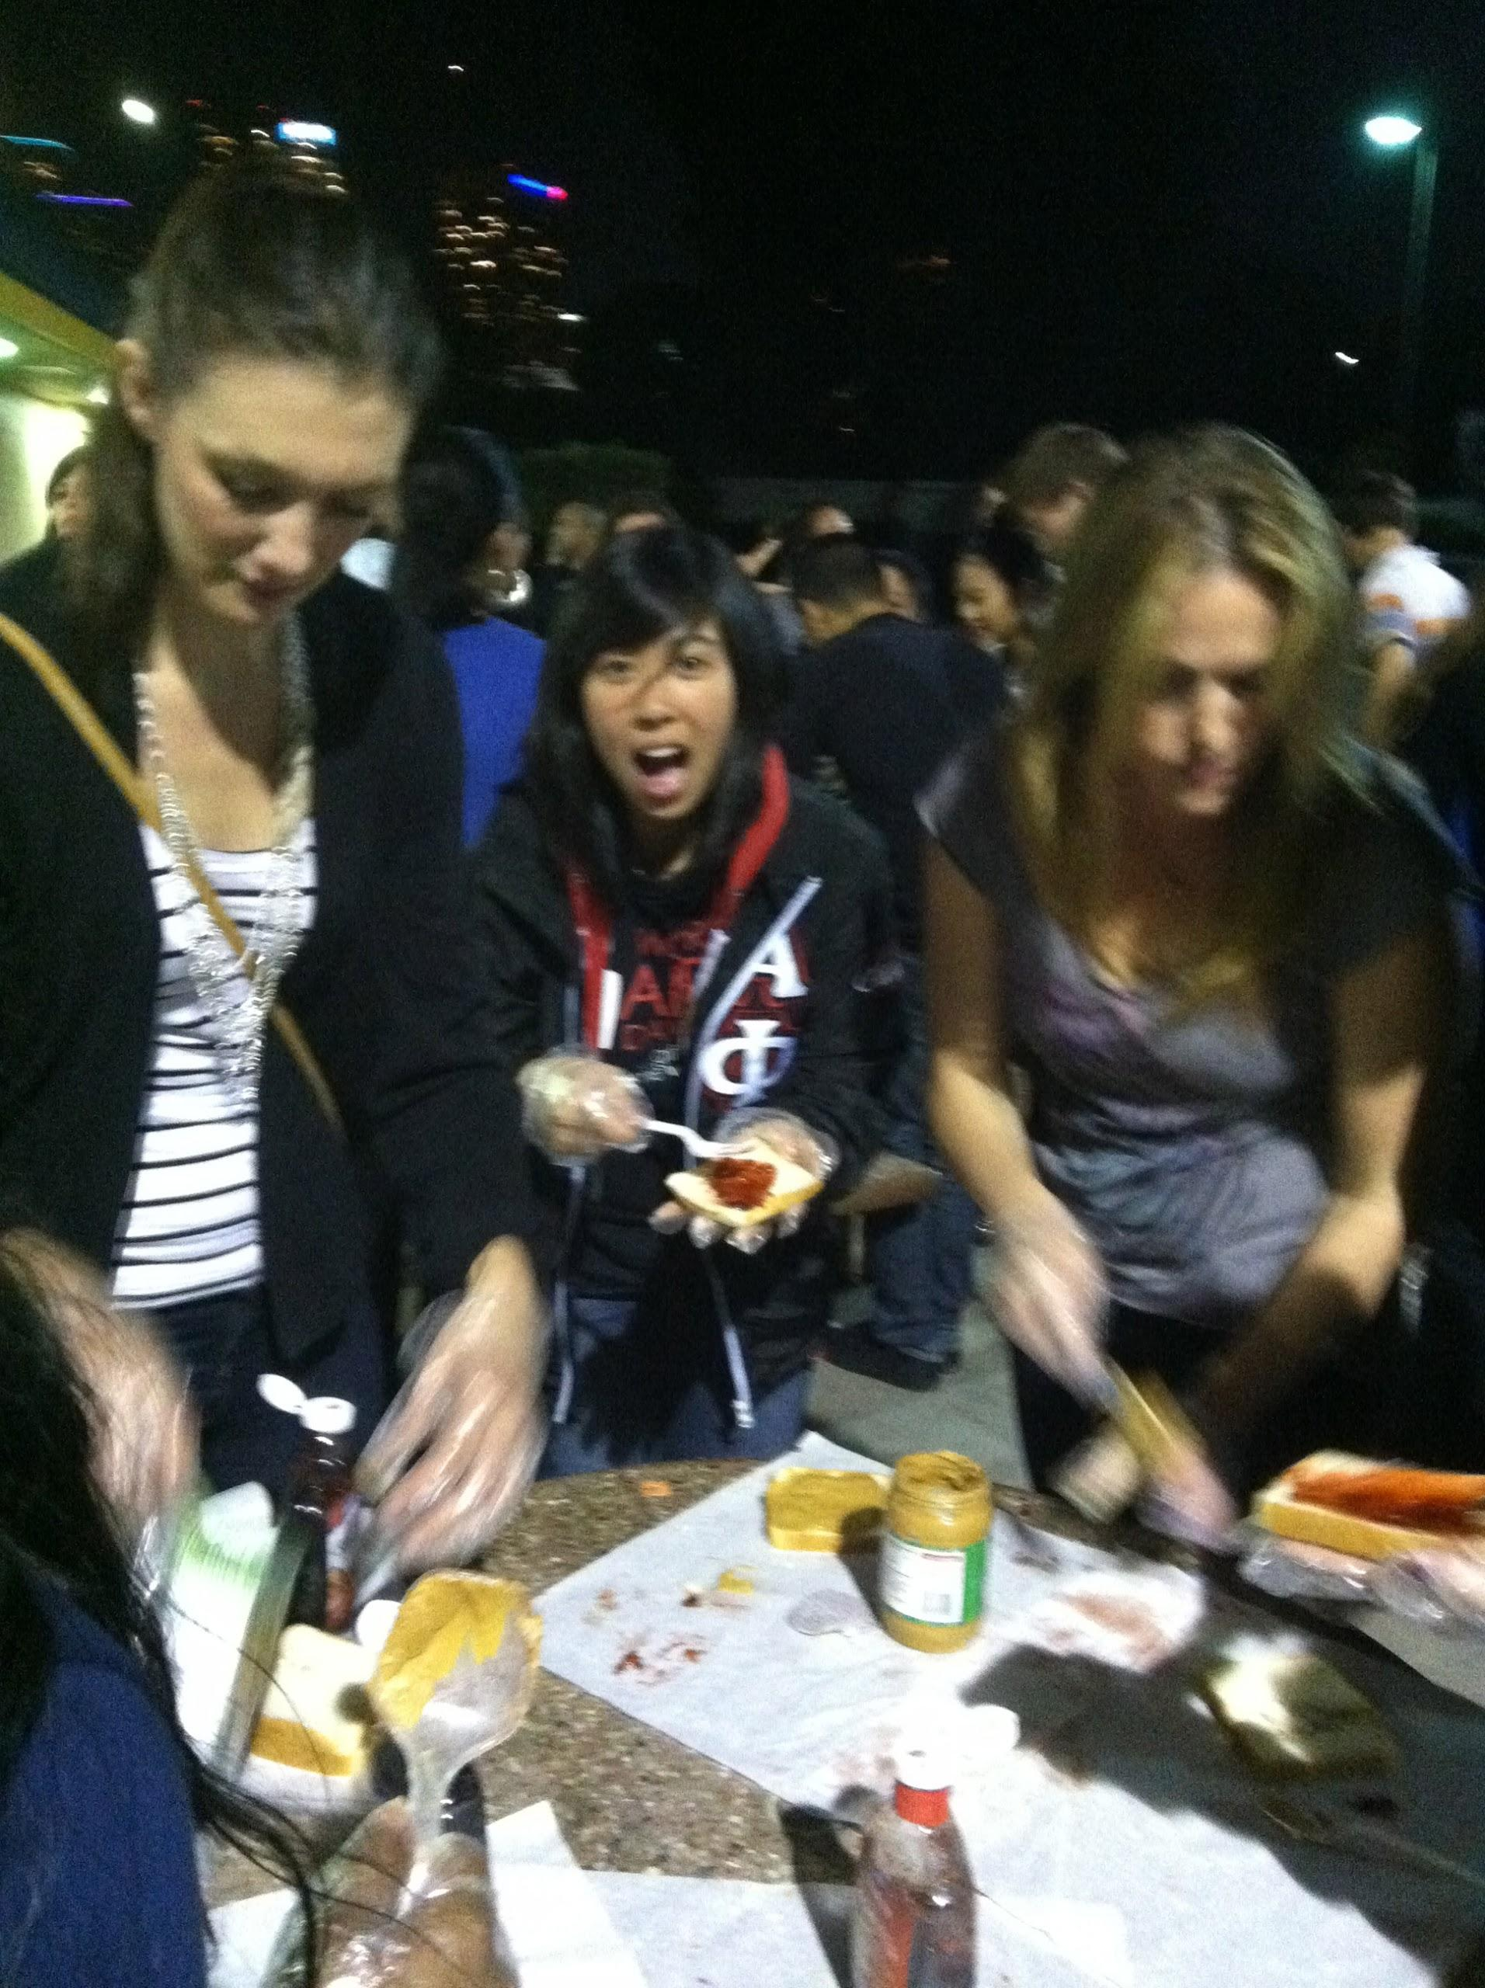
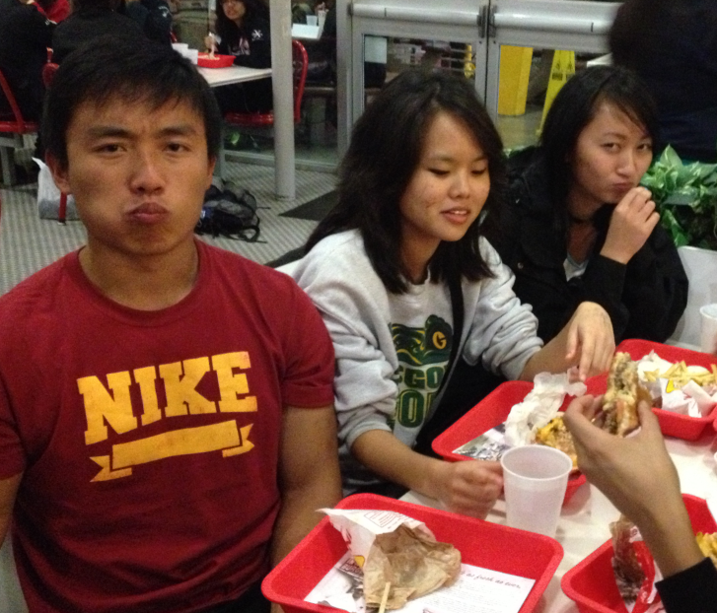
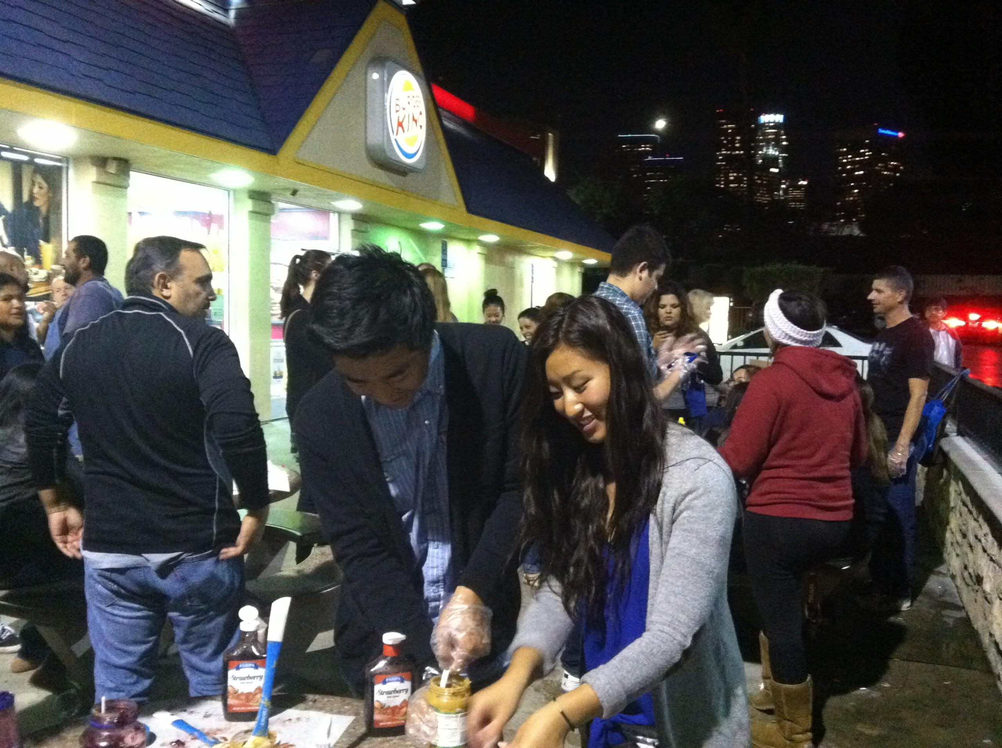
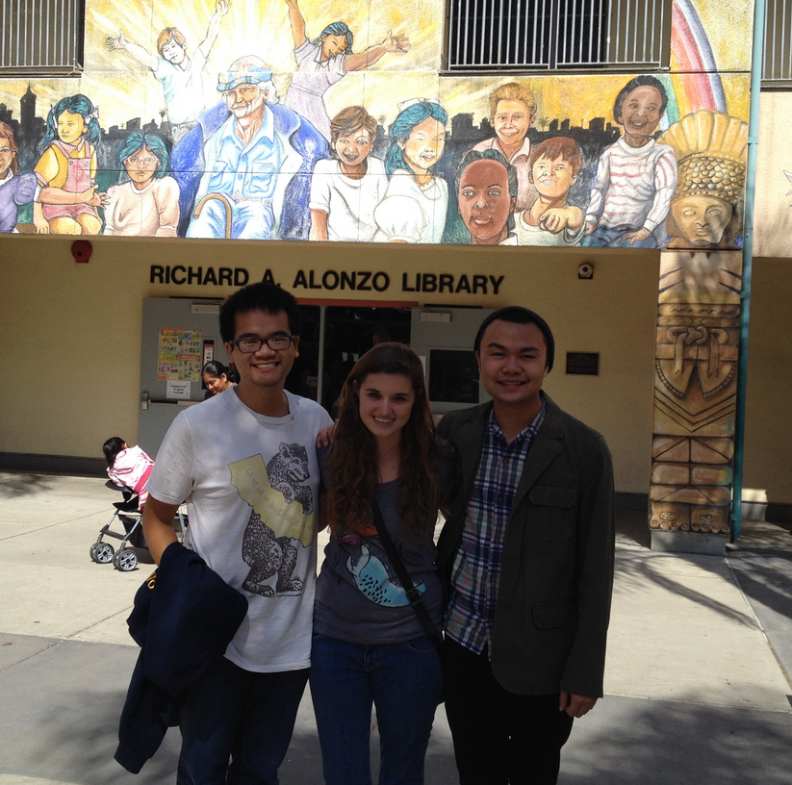
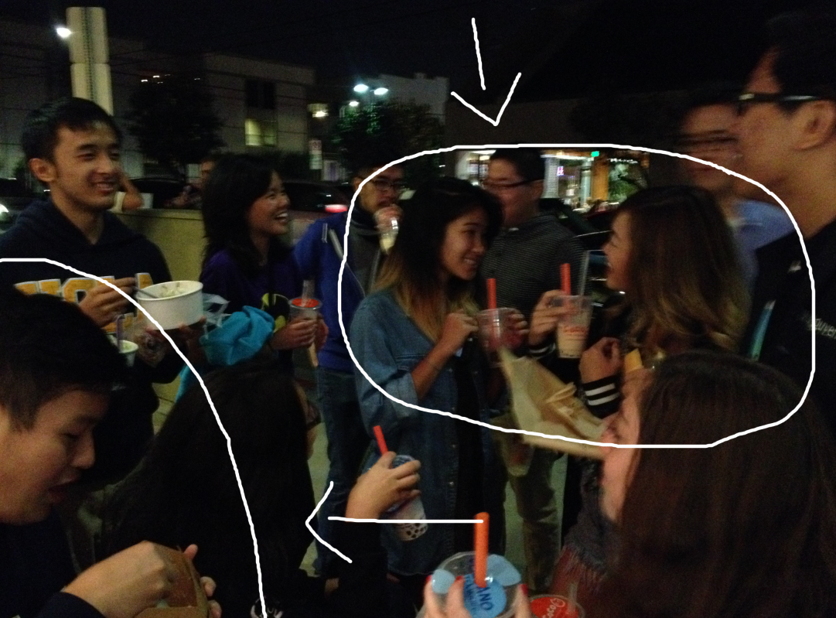
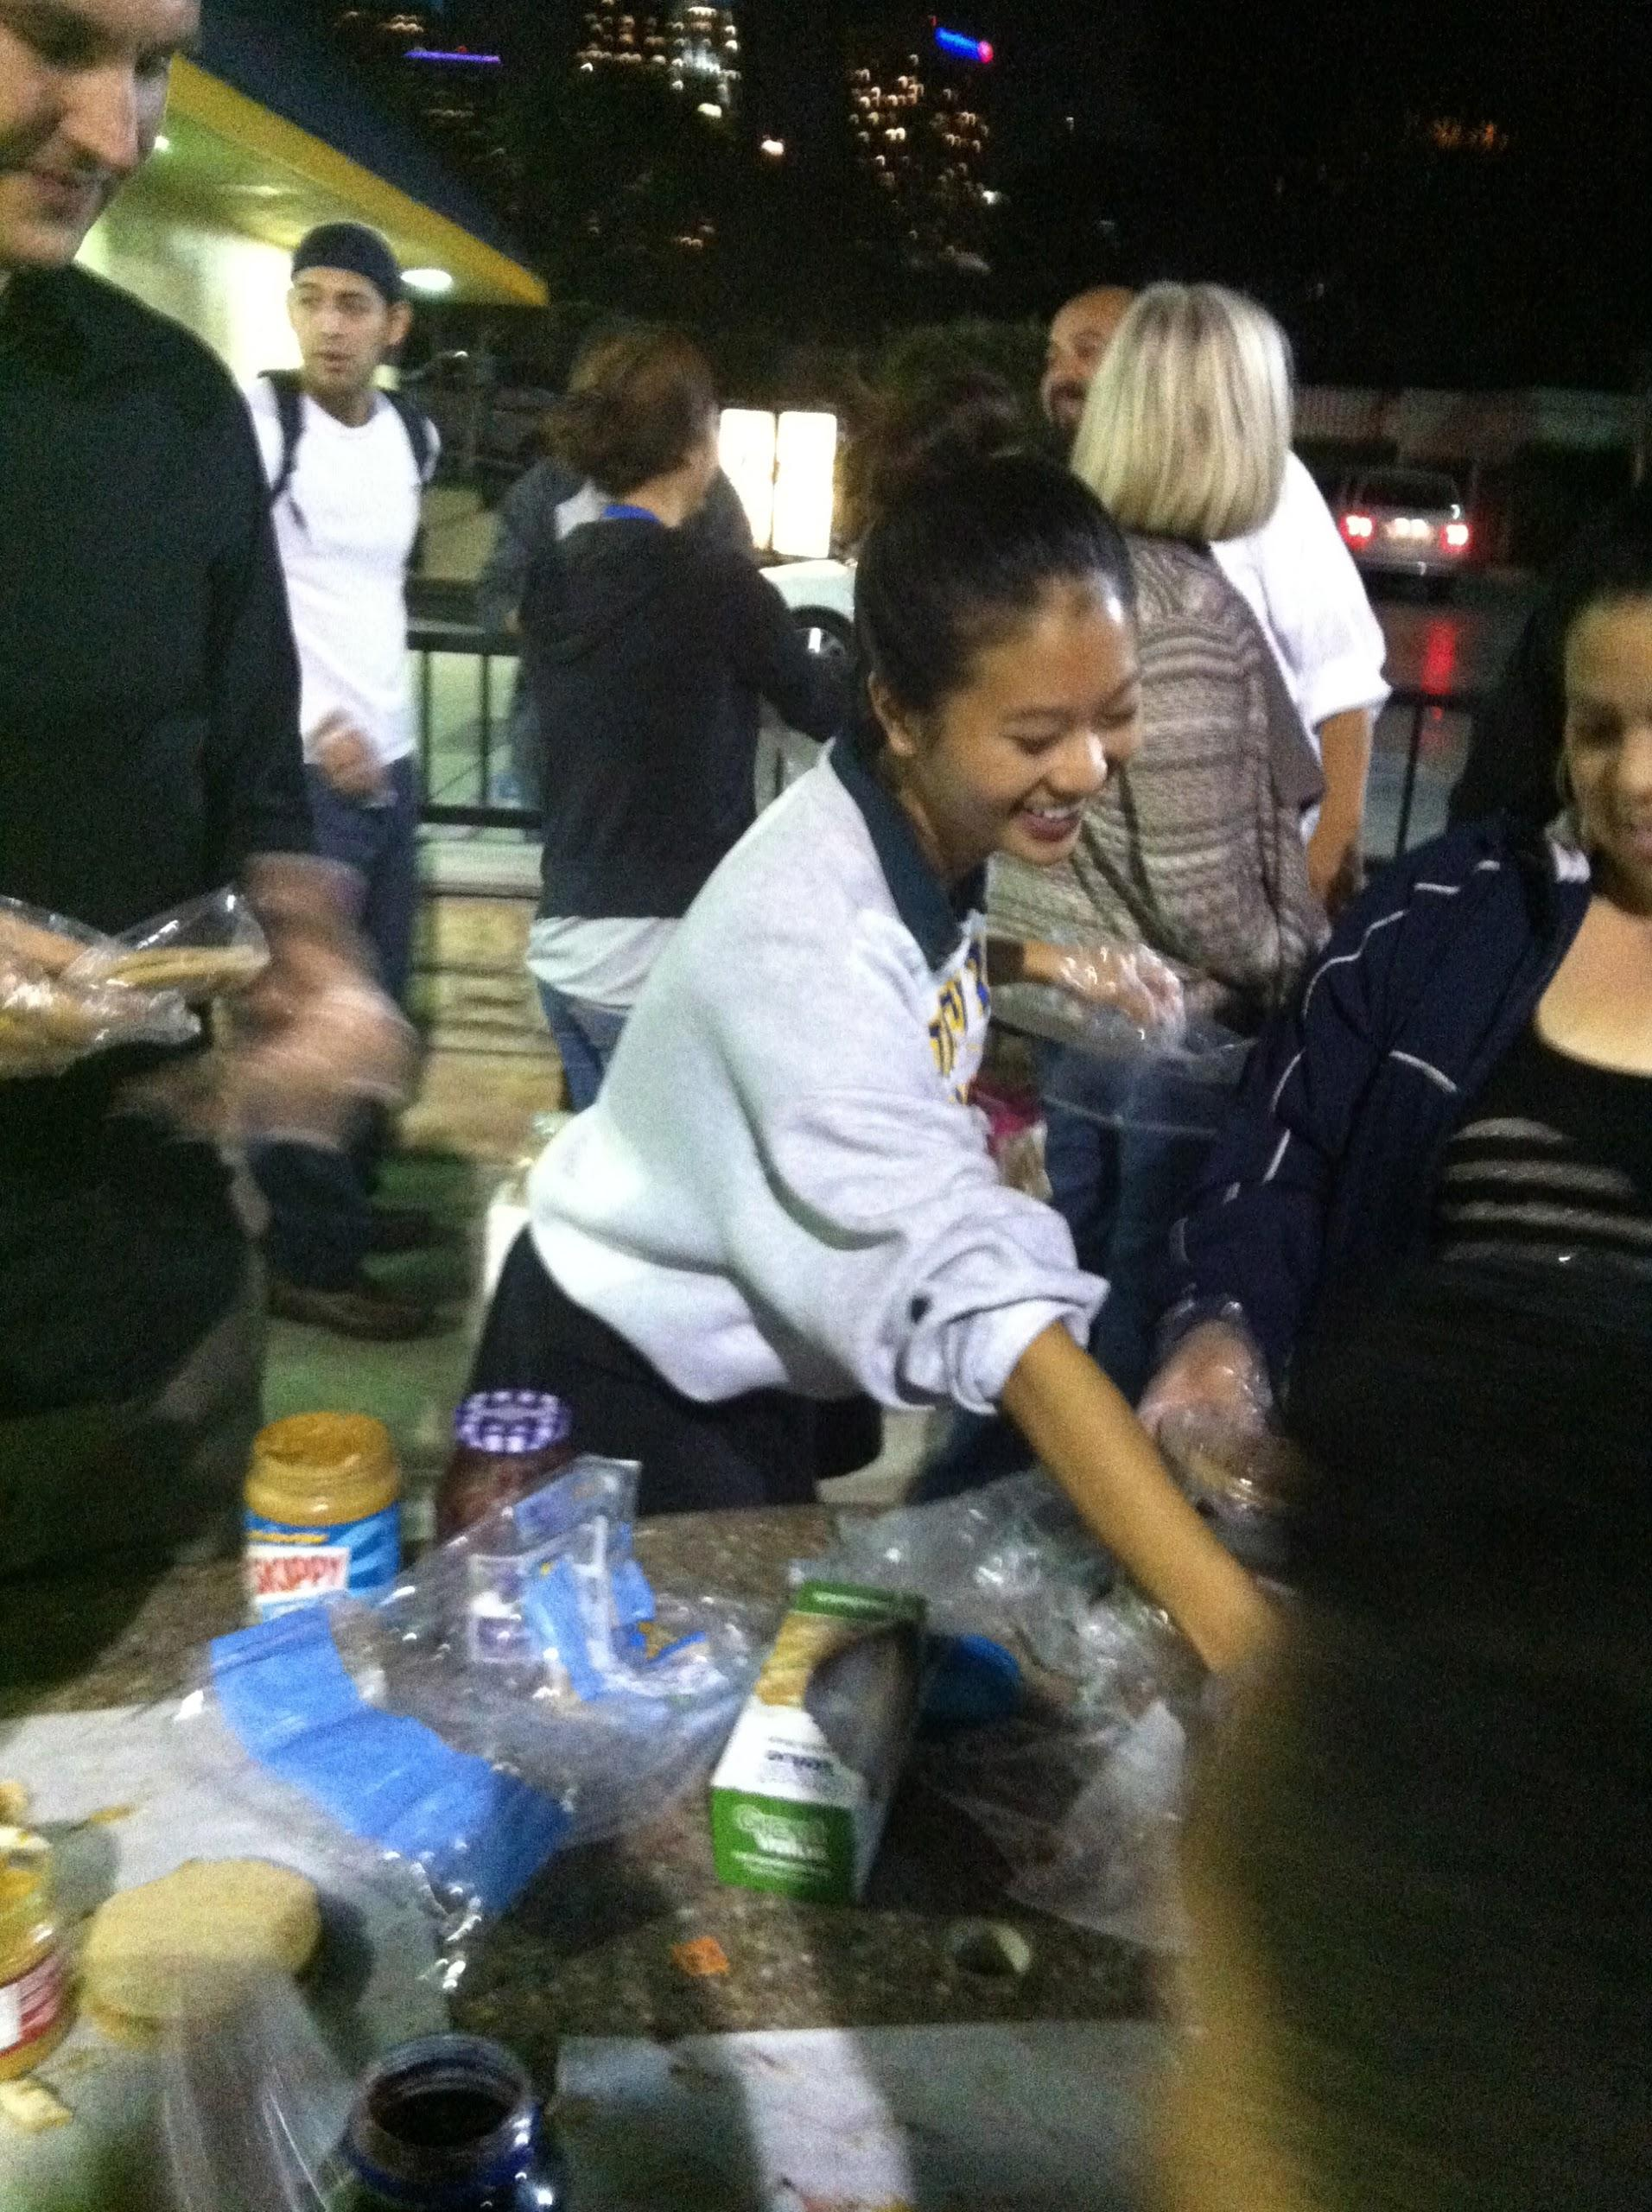
Special Thanks to...

Slide 55
Join My Committees :D
Apo Webisode (3)
-Along with the other two committee members create a minimum of 3 webisodes! It’s a fun task plus you earn the committee credit! :D Please Join!
Light Bulbs / Slideshow (2)
-Assist in creating new and interactive ideas to share Chi Chapter history to the chapter
-In addition, you will be making the Banquet Slideshow!
BOTW (1)
-Help me Nominate a brother who has gone and beyond in exemplifying our 3 principles! (Leadership, Friendship, and Service )

Slide 56
Sergeant-at-Arms
Maria Valenzuela
saa@apo-x.org

Slide 57
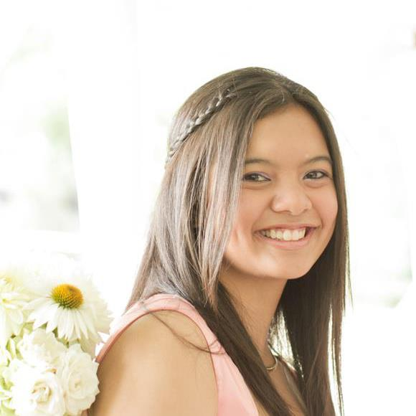
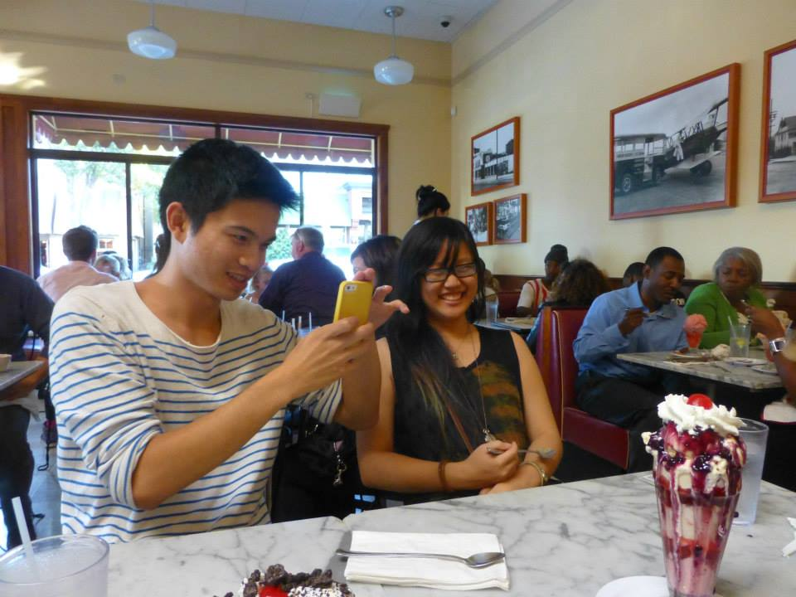
Committee Members
Attendance:
Tin Tran
Catherine Teotico
KISS/ Quiet Committee:
Miye Nakashima

Slide 58
Chairing
Sign up to become the chair for an event on the Chapter Website.
Email all listed attendees, SAA, and the respective VPs 3 days prior to the event, with relevant information (location, time, pin/letters, special instructions).- Even if the event is that day.
Call all attendees 1 day prior to the event via telephone reminding them of the event and provide relevant information. If an attendee cannot be reached, leave a voice-mail. - Remember phone etiquette, call at common sense times. 9am/10pm
Arrange rides if necessary and provide clear directions/maps for the drivers.
Go to the event, take attendance, check for pins/letters, and maintain order within the attendees. Take pictures or video of the event. (Whenever possible, any social media sharing of the event is also encouraged.)
Clean up, thank the event coordinators (if present/relevant), and sing the Toast Song. Note: Toast Song is mandatory for all Chapter, Interchapter, and Service events.

Slide 59
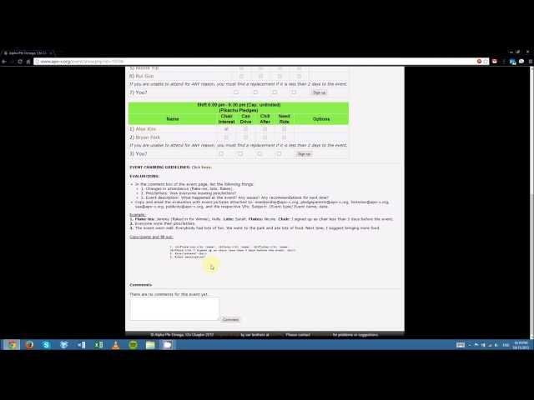
Evaluation Tutorial

Slide 60
Evaluations
In the comment box of the event page, list the following things:
1. Changes in attendance (flake-ins, late, flakes).
2. Pins/letters: Was everyone wearing pins/letters?
3. Event description: What happened at the event? Any issues? Any recommendations for next time?
Copy and email the evaluation with event pictures attached to: Membership VPs, Pledge Parent, Historian, SAA, the respective VPs, and Publicity Committee; Subject: [Event type] Event name, date.
Please make all your evaluations interesting

Slide 61
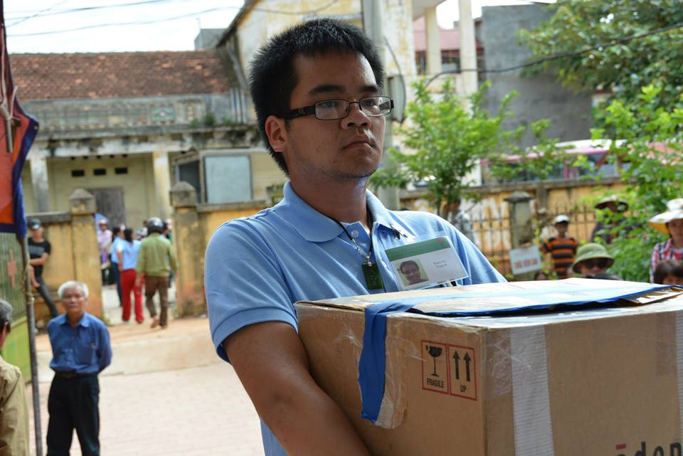
A.B.E.A
Peter Vo
[Service] Reading
For Kids 10/12/13
Very descriptive. Lead me from
beginning to the end of the service event.
* Thank you for ensuring your attendees arrived in a timely fashion.

Slide 62
Interchapter Chair
Olivia Pardo
interchapter@apo-x.org

Slide 63

WELCOME LAMBDA MU!

Slide 64
Updates & Reminders
IC Penpal with Alpha Kappa
Still interested? Contact me!
Join my committees!
ICDC Committee (3)
IC Penpal (2)
More events to be posted! ^__^

Slide 65
Chair of the
Advisory Committee
Tristan Darvin
cac@apo-x.org

Slide 68
Chapter Business

Slide 69
Last Announcements

